Slide 2
Irish Hauliers Training Pack
Subtitle goes here

Slide 3
01
Safety Principles – PPE
02
Safety Principles – Loose equipment standards
03
Safety Principles – Tractor unit standards
04
Safety Principles – Trailer unit standards
05
Loading and Unloading

Slide 4
Safety Principles
Equipment Standards

Slide 5
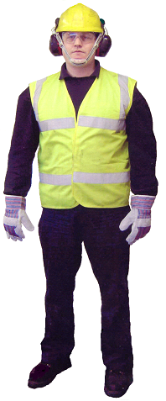







Personal Protective Equipment
Personal Protective Equipment
The Seven items of PPE that every driver
should have

Slide 6

Loose Equipment standards
Transport chains compliant with EN 12195-3.
8mm chains.
  Lashing capacity of 4 tonnes.
  Down-rate to 3 tonnes due to bending
10mm chains.
  Lashing capacity of 6 tonnes.
  Down-rate to 4.5 tonnes due to bending

Slide 7
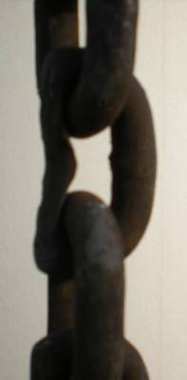
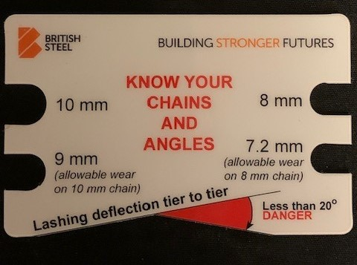
Chain failure and wear
Chains always break first where links are bent,
e.g. end hooks, edge of tray, at the hooks on the ‘dog”
Inspect for wear - discard if more than 10% of section damaged or worn
Look for the “key hole effect”
O
See Technical Information Sheet TIS-0004
Transport Chains & Tensioners

Slide 8
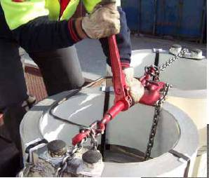

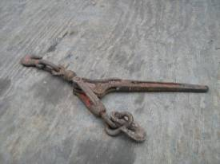
Chain Tensioners
Webbing tensioner for chains
Typical LC 2.5 tonnes
Recently banned
O
Banned – ‘Sylvester’
Turnbuckle or ‘barrel’ type
Typical LC 4 tonnes force
Typical pre-tension 750kgf – 1 tonne
P
O

Slide 9
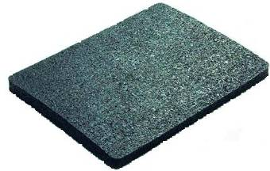
Anti Slip matting
Specialised Anti-Slip Matting
  Coefficient = at least 0.60 wet or dry
  3-20 mm thick; about 8-10 mm optimal
  NOT a universal solution - can wear rapidly - inspect before use
  NEVER USE AS EDGE PROTECTION!! It cuts easily
Conveyor belting
  Harder = Slippery
  Wet - sometimes very slippery
  Typical friction about 0.40
See Technical Information Sheet TIS-0008
Anti-slip matting

Slide 10
Safety Principles
Tractor and Trailer Standards

Slide 11
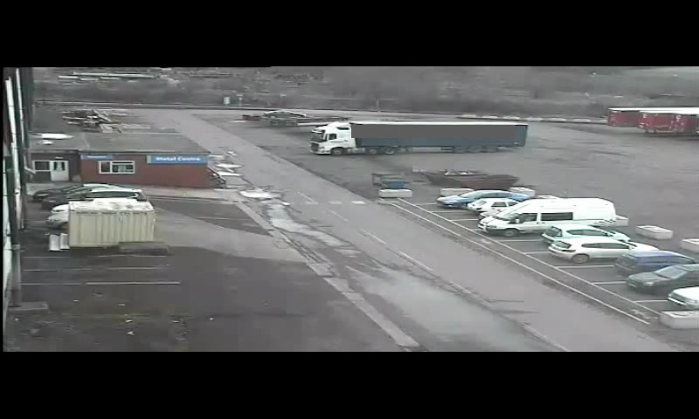
Rotherham Roll Away

Slide 12
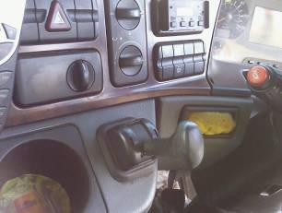

Tractor unit standards

Slide 13
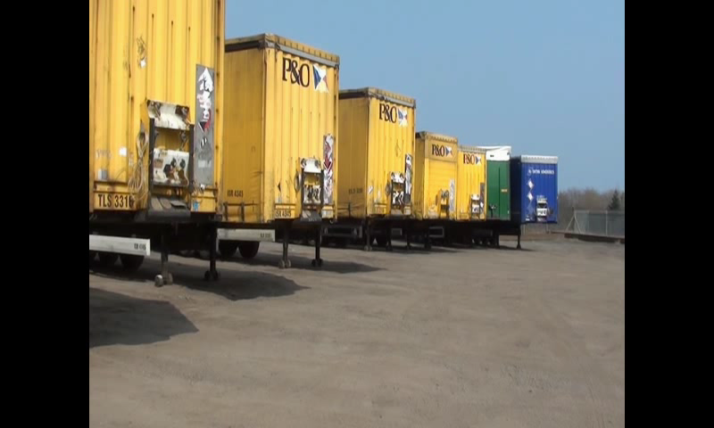
Tractor unit standards

Slide 14
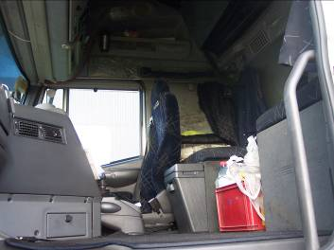
Tractor unit standards

Slide 15

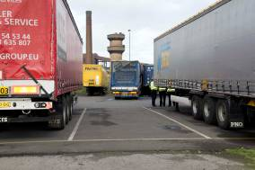
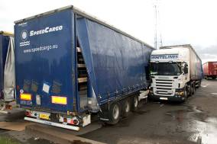
Trailer standards
Saturday 28th August 2010, Scunthorpe, UK
What happened:
  Driver came to collect a loaded trailer
  He dropped his empty trailer and then reversed under the loaded trailer
  Engine was running. Handbrake was NOT applied
  Tractor and trailer rolled away
  Driver tried to get back into the tractor unit to stop it.
  Driver was crushed to death
Learnings
  Standard:
    Handbrake must be applied
    Engine off
    Keys out

Slide 16
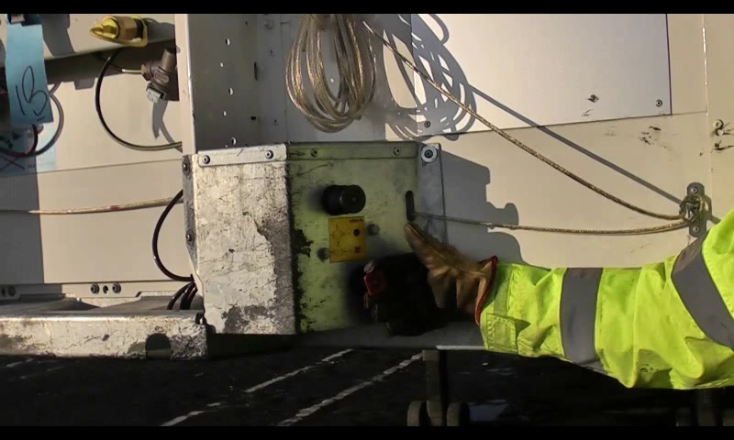
Trailer standards

Slide 17

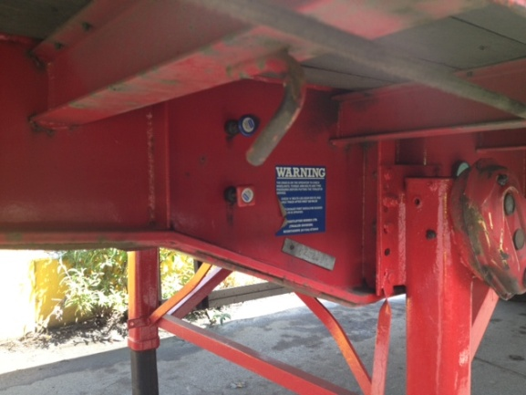
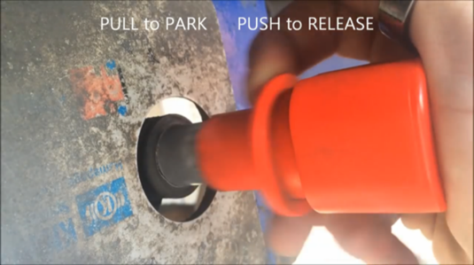
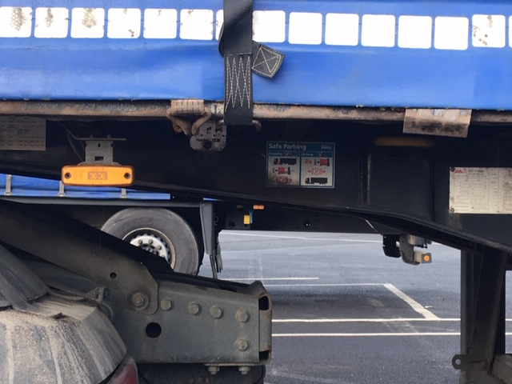
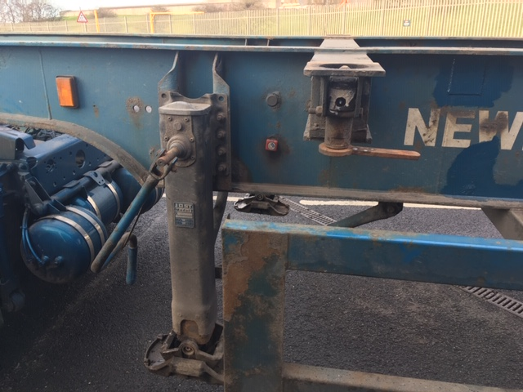
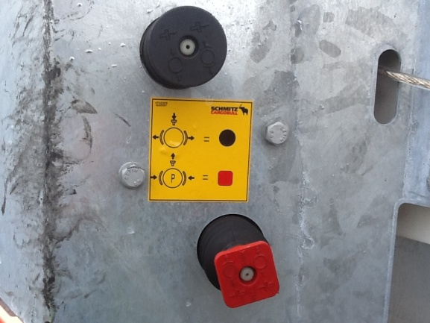
Trailer park brakes

Slide 18
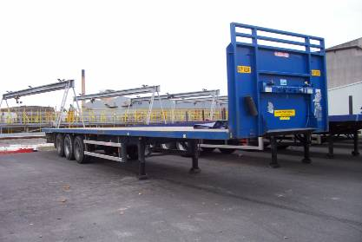
Trailer headboards

Slide 19
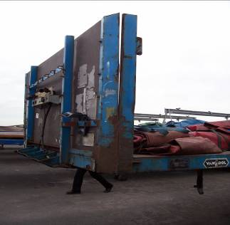
Trailer headboards
EN 12642:2006
Code L: 5 tonnes max load
Code XL: 50% of payload (spread over the face of the headboard)
Loading away from the headboard can generate major impact forces – up to 3 times the weight of the product
Headboards
Check condition
Check specification
Many older trailer headboards are not rated at all

Slide 20
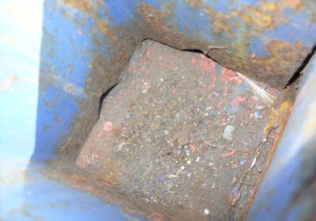
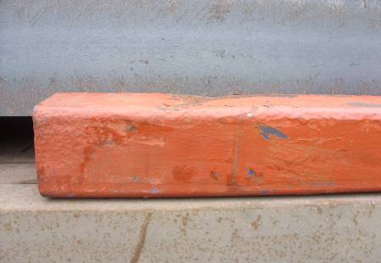
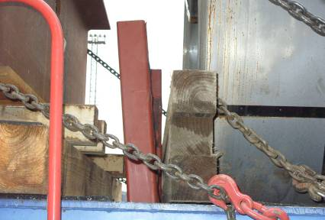
Trailer stanchion posts and sockets
Varying sizes
  Minimum 80 x 80 x 5mm thick
Condition / corrosion
  Can seriously weaken posts
  Should be inspected / maintained
Must be kept clean and clear of debris!

Slide 21
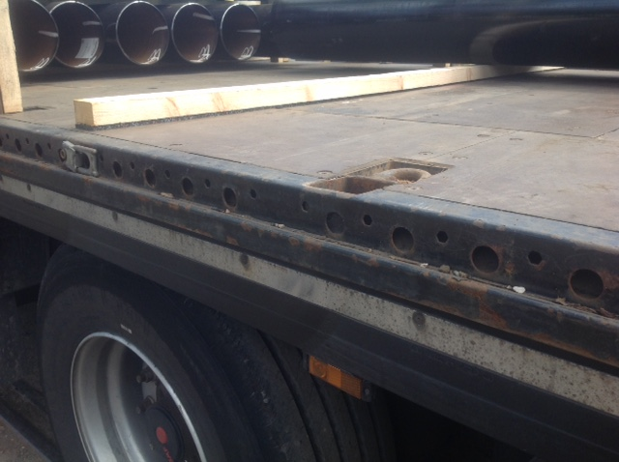
Trailer anchor points
Don’t over-load by putting 2 or more lashings to one point
- unless they work in different directions
See Technical Information Sheet TIS-0009
Lashing points

Slide 22
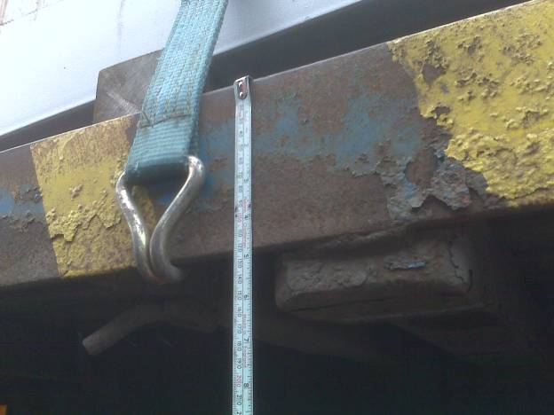
Trailer lashing points
Some side raves are substantial enough – others are not
< 6mm
Must use edge protection
Attach near a cross member to avoid sliding
Many flat-bed trailers don’t have lashing points

Slide 23
Loading and Unloading

Slide 24
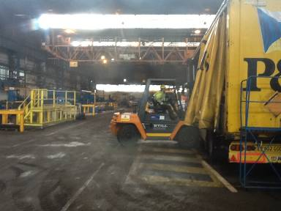
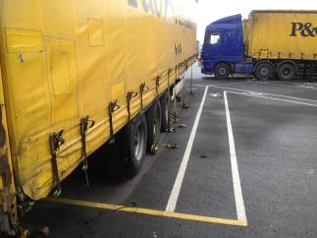
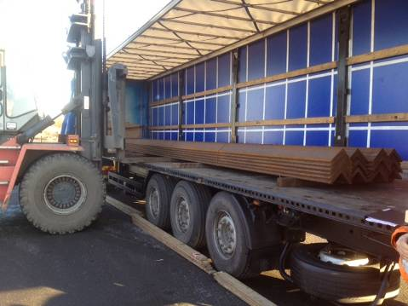

What vehicle dangers are there?
Trailer Park
Warehouse Loading Area
Overhead Loading Area
Outside Loading Area

Slide 25
Loading and Unloading Safety Principles
BE CLEAR – STAY CLEAR
SEE and BE SEEN
You must be aware and look for dangers around you
You must make sure that you are visible to moving vehicles
You must stay clear of moving vehicles, forklifts and loads
How . . .
  Stop and Wait
  Make eye contact with vehicle, crane and forklift drivers
  Seek acknowledgement from vehicle, crane and forklift drivers before moving or approaching
  Keep a safe distance (minimum 2 metres) from vehicles, cranes and forklifts
  Wear High – visibility clothing

Slide 26



Loading and Unloading Safety Principles

Slide 27
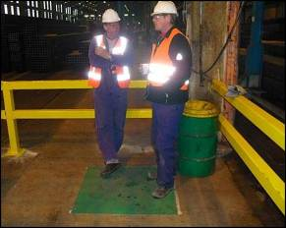
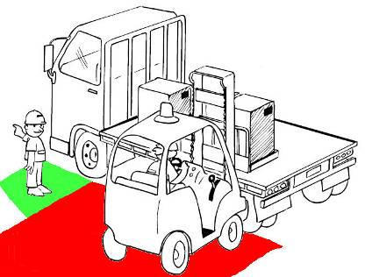
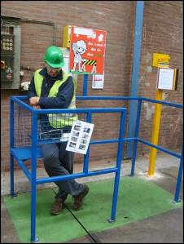
Loading and Unloading Safety Principles
BE CLEAR and STAY CLEAR
Stay in SAFE ZONES when loading

Slide 28
BREAK

