Slide 2
Irish Hauliers Training Pack
Subtitle goes here

Slide 3
01
Working at Height
02
Defect and Incident Reporting
03
Axle weights
04
Load Restraint Guidelines
05
Site Rules

Slide 4
Working at height

Slide 5
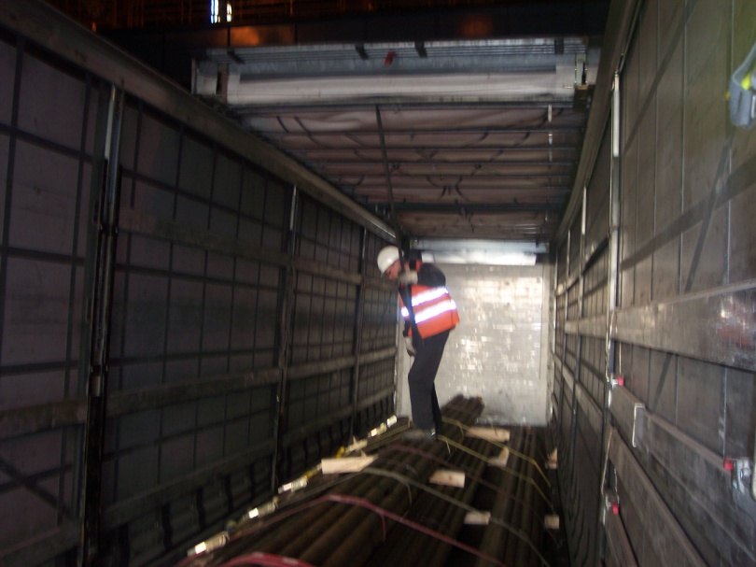
Working at height
✗

Slide 6
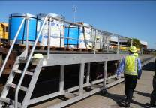
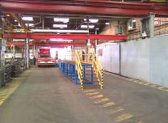
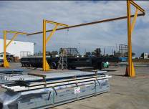
Working at height
AVOID WORKING AT HEIGHT - Can the work be done at ground level?
Avoid Getting Up At All, If You Can!
DO NOT WORK NEAR THE OPEN EDGE
Use Platforms, steps and fall Protection systems…..

Slide 7
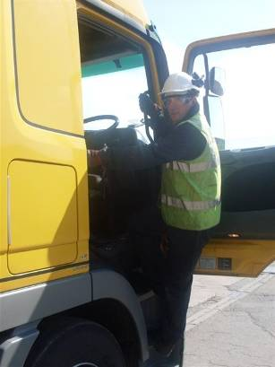
Working at height
Use 3 points of contact where possible
1
2
3

Slide 8
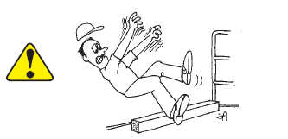
Working at height
Never step backwards!

Slide 9
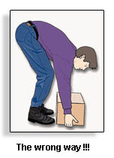
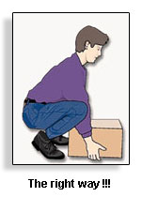
Working at height
Always keep your head above your shoulders!
✗
✓

Slide 10
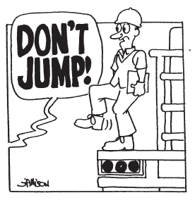
Working at height
Never jump off your trailer!

Slide 11







Working at height
Hard Hats with Chin Straps have prevented many serious injuries in falls from trailers

Slide 12
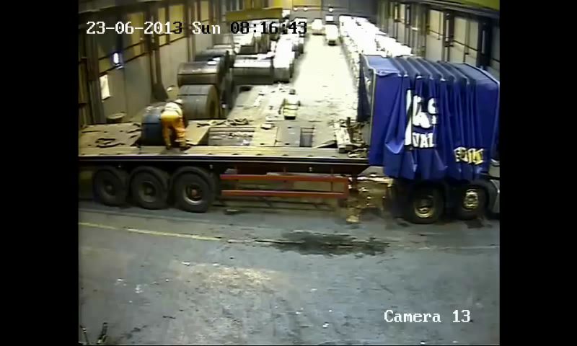
Working at height

Slide 13
Defect Reporting

Slide 14

Defect Reporting
All hauliers should have their own Defect Reporting Procedure
If a driver encounters a problem with his trailer, they should know who to contact to report the fault
The fault should be logged and repaired as soon as possible

Slide 15
Defect Reporting
Do you know how to report defects?

Slide 16
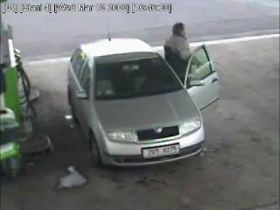
Defect Reporting

Slide 17
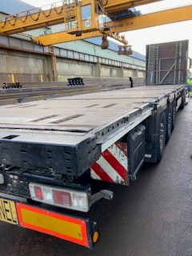
Pre arrival checks
Do I have all the equipment I need?
  Personal Protection Equipment
  Load securing equipment (correct number of chains; timbers)
Is my equipment in a good condition?
  Is my trailer bed dry, clean and tidy?
  Are stanchion posts fit for purpose?
  Stanchion sockets clean and free from debris?

Slide 18
Incident Reporting

Slide 19
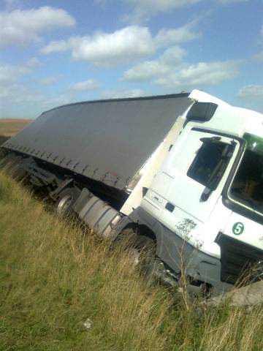
What to do in the event of an incident
Find a Safe Place away from moving traffic (ideally behind barriers)
Be aware of hazards and moving traffic
Remain calm
Call the emergency services if
  anyone is injured,
  load has exited the trailer
  serious damage to vehicles or property
Call your transport office
Record Information of events
  Description of incident, including times
  and 3rd parties involved
  Photograph the scene / load / trailer /
  tractor unit

Slide 20
What information do we need?
Any personal Injuries or damage (to product and equipment)
Location, date and time
Weather, traffic conditions, road surface, lighting
Write a statement / description of events
  What happened to cause the incident
  Before, during and after
Speed at time of accident
Securing equipment (photographs)
  Number of straps
  Number of broken straps
  Position of straps and other restraints (edge protection, stanchions)
  Position of timbers
Load (photographs)
  Position of load before and after incident
  Damage to load / trailer / tractor unit

Slide 21
Why do we need this?
To investigate what went wrong
To recommend actions
To learn from experience and events to Prevent Future Accidents

Slide 22
Axle weights

Slide 23
Axle Weights
Overweight on the Tractor Unit Drive Axle
Overweight on the Trailer axle
The driver is responsible for the positioning of the load and
ensuring they are not overweight on their drive or trailer axle
The Customer also has a legal responsibility to assist the driver as far as reasonably practicable

Slide 24
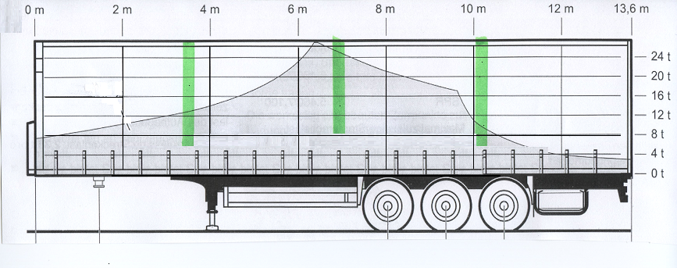
Axle Weights
8 ton
8 ton
8 ton
Notes:
Trailers commonly used on the European traffic are allowed to have 8 ton on each of the trailer axle.
An additional complication and consideration is the difference axle weight requirement for 2 and 3 axle tractor units. Although in the UK you may not have to worry about axle weights with 3 axle units, when on the continent, the trailer will always be collected by a 2 axle tractor unit, and the positioning of the load to comply with axle weights is key
When positioning loads the following generic guidance can be followed.

Slide 25
Axle Weights – 24 ton
12m
Centre of Gravity

Slide 26
Axle Weights – 24 ton
9m
Centre of Gravity

Slide 27
Axle Weights – 24 ton
7m
Centre of Gravity

Slide 28
Axle Weights – 24 ton
6m
Centre of Gravity

Slide 29
Axle Weights – 24 ton
6m
7m
9m
12m
Centre of Gravity

Slide 30
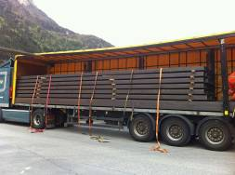
Axle Weights – Signs of overloading
Load not spread over the back axle
Road marks
Flat spots on the tyres
Vehicle struggling to pull away (having to use crawler gears)

Slide 31
THANK YOU

