Slide 1
Loading and Unloading Safely
P&O Ferrymasters
Driver Training Programme 2019 v1

Slide 2
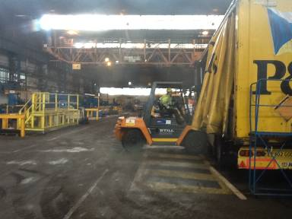
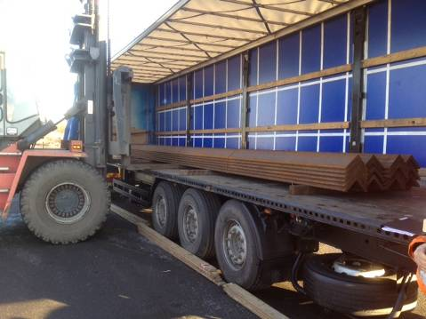
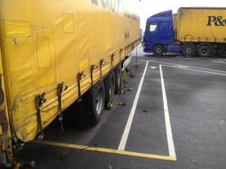
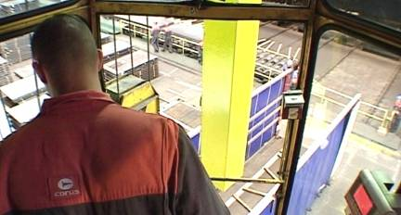
What vehicle dangers are there?
Trailer Park
Warehouse Loading Area
Overhead Loading Area
Outside Loading Area

Slide 3

Loading and Unloading Safely - Principles
BE CLEAR – STAY CLEAR
SEE and BE SEEN
You must be aware and look for dangers around you
You must make sure that you are visible to moving vehicles
You must stay clear of moving vehicles, forklifts and loads
How . . .
  Stop and Wait
  Make eye contact with vehicle, crane and forklift drivers
  Seek acknowledgement from vehicle, crane and forklift drivers before moving or approaching
  Keep a safe distance (minimum 2 metres) from vehicles, cranes and forklifts
  Wear High – visibility clothing

Slide 4



Loading and Unloading Safely

Slide 5
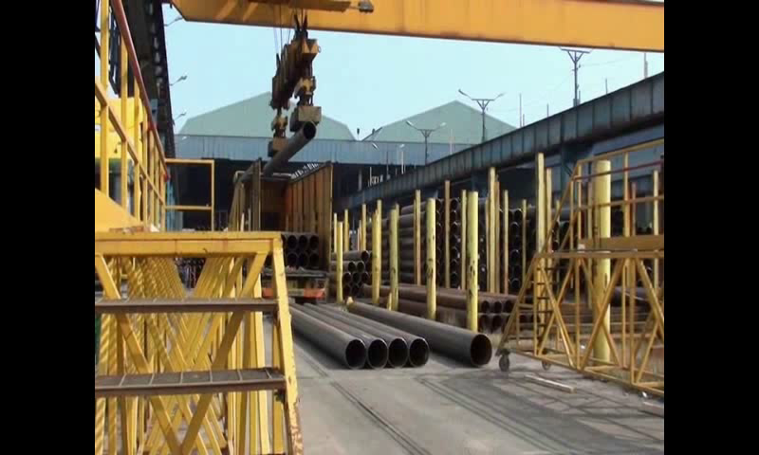
Importance of safe zones……

Slide 6
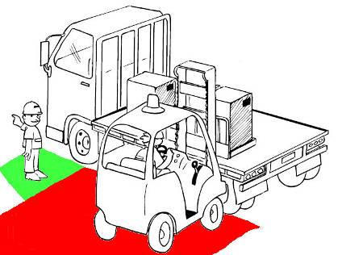
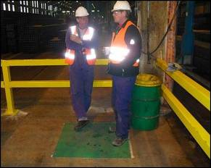
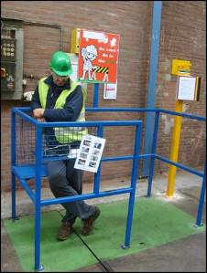
Loading and Unloading Safely
BE CLEAR and STAY CLEAR
Stay in SAFE ZONES when loading

Slide 7
Quiz
What is the safe minimum distance to keep from moving vehicles?
What do you need to think about when being unloaded by a fork lift truck?
What is the difference between an Exclusion Zone and a Safe Zone?
An Exclusion Zone is the area around the vehicle to be loaded. No one allowed inside this area.
A Safe Zone is where the Driver should stand during loading.
2 metres
Stay clear of moving vehicles - BE CLEAR STAY CLEAR,
Be visible to moving vehicles - SEE and BE SEEN
Use Safe Zones

