Slide 1
UK and European Laws
UK
Road Vehicles (Construction and Use) Regulations 1986
Road Traffic Act 1988 Regulation 40A
Health & Safety at Work act 1974
NETHERLANDS
Ministerie van Verkeer en Waterstaat: Wegenvekeerswet 1994
GERMAN
Straßenverkehrs-Ordnung (StVO): 2009
Consigning
Loading
All Authorities agree that everyone involved in the Transport Chain has a shared responsibility to ensure that the goods are correctly positioned and secured
Carrying
Driving
Receiving

Slide 2





Enforcement in the UK
HSE view steel loads as the highest risk on the highways.
Enforcement in UK, NL and other EU countries has historically been weak – but not anymore!

Slide 3



Enforcement in Europe
Dienst Vekeerspolitie
Unit MTC
German police have specialists trained in Load Restraint, and have guidelines that they follow e.g. expect to see anti-slip matting used.
Different regions may have slightly different interpretations of requirements.
Chain of responsibility moving back down the line from the driver to the loader and consigner.

Slide 4
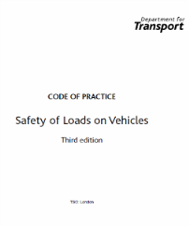
Load Restraint – Key guidance documents
DfT Code of Practice
1st Edition 1972; 3rd Edition 2002
UK
EN 12195-1:2010
EU
VDI: 2700 – 2011
Germany
Note that UK law does not specifically reference any of the guidance documents, but … the enforcing agencies do!

Slide 5

Load Restraint Standards – Forces under EN12195
0.8g forward
0.5g backwards
0.5g sliding
0.6g toppling

Slide 6
Load Restraint – against forward forces – G Force
  80% of the weight forwards
    Under heavy braking the forces are equal to about 60%
    Collision with a light vehicle will raise this to 80%
80% of the weight forwards (0.8 g)

Slide 7
Forces in European EN12195 - Road
toppling
0.8g forward
0.5g back
EN 12195-1:2010
1.0g vertically
0.5g sliding
0.6g toppling

Slide 8
Forces in European EN12195 - By Sea
0.3g vertically
B
0.3g forward
0.3g back
EN 12195-1:2010
1.0g vertically
0.7g sliding
0.7g toppling

Slide 9
Forces in European EN12195 - Intermodal
0.6g toppling
1.0g forward
1.0g back
EN 12195-1:2010
1.0g vertically
0.5g sliding
0.5g toppling

Slide 10
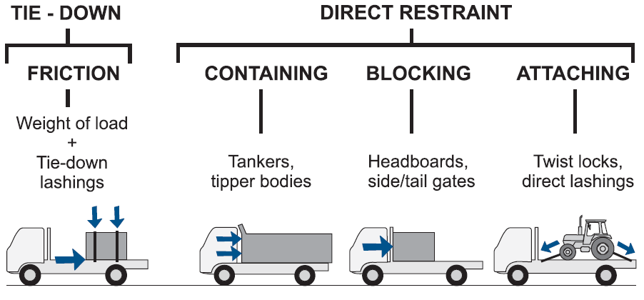
Load Restraint Methods
Direct Restraint
Tie-Down Lashing
Direct Lashing
Containing
Blocking
Relies upon friction
Can use a combination to form a SYSTEM

Slide 11
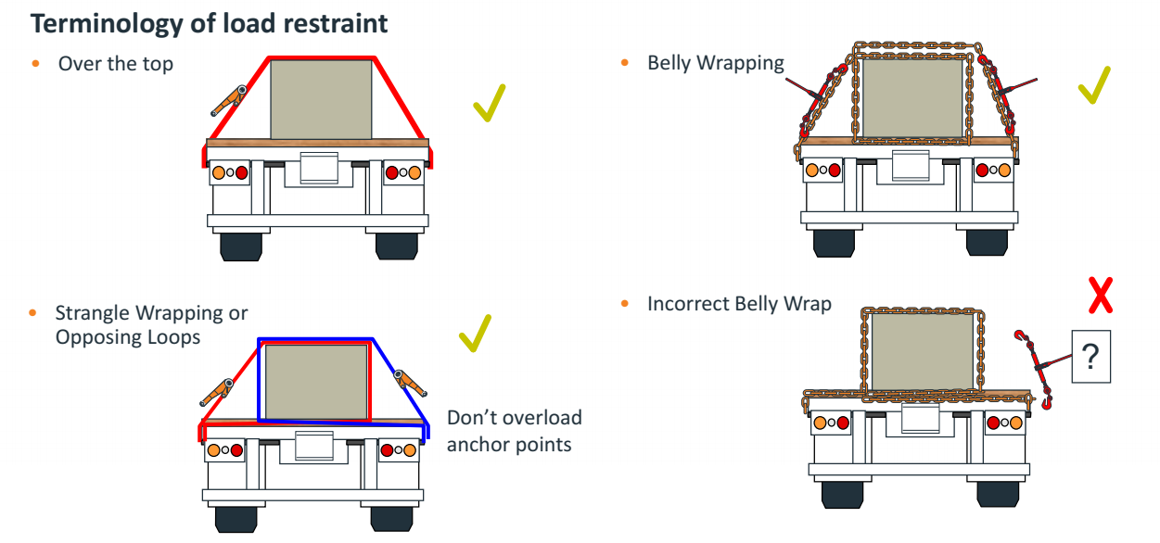
Load Restraint Methods

